Slide 1
Write a PHP script to sort the following associative array : array("Sophia"=>"31","Jacob"=>"41","William"=>"39","Ramesh"=>"40") in
a) ascending order sort by value b) ascending order sort by Key c) descending order sorting by Value d) descending order sorting by Key

Slide 2
<?php
echo " Associative array : Ascending order sort by value ";
$array2=array("Sophia"=>"31","Jacob"=>"41","William"=>"39","Ramesh"=>"40");
asort($array2);
foreach($array2 as $y=>$y_value)
{
echo "Age of ".$y." is : ".$y_value." ";
}
echo " Associative array : Ascending order sort by Key "; $array3=array("Sophia"=>"31","Jacob"=>"41","William"=>"39","Ramesh"=>"40");
ksort($array3);
foreach($array3 as $y=>$y_value)
{
echo "Age of ".$y." is : ".$y_value." ";
}
echo " Associative array : Descending order sorting by Value "; $age=array("Sophia"=>"31","Jacob"=>"41","William"=>"39","Ramesh"=>"40");
arsort($age);
foreach($age as $y=>$y_value)
{
echo "Age of ".$y." is : ".$y_value." ";
}
echo " Associative array : Descending order sorting by Key "; $array4=array("Sophia"=>"31","Jacob"=>"41","William"=>"39","Ramesh"=>"40");
krsort($array4);
foreach($array4 as $y=>$y_value)
{
echo "Age of ".$y." is : ".$y_value." ";
}
?>

Slide 3
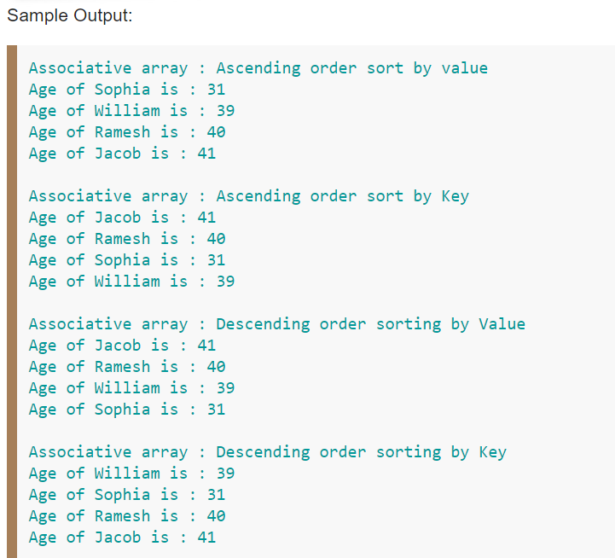

Slide 4
Write a PHP program to merge (by index) the following two arrays.
Sample arrays : $array1 = array(array(77, 87), array(23, 45)); $array2 = array("w3resource", "com"); Expected Output :
Array ( [0] => Array ( [0] => w3resource [1] => 77 [2] => 87 ) [1] => Array ( [0] => com [1] => 23 [2] => 45 ) )

Slide 5
<?php
$array1 = array(array(77, 87), array(23, 45)); $array2 = array("w3resource", "com");
function merge_arrays_by_index($x, $y)
{
$temp = array();
$temp[] = $x;
if(is_scalar($y))
{
$temp[] = $y;
}
else
{
foreach($y as $k => $v)
{
$temp[] = $v;
}
}
return $temp;
}
echo '<pre>'; print_r(array_map('merge_arrays_by_index',$array2, $array1));
?>

Slide 6
Write a PHP program to get the index of the highest value in an associative array.
<?php
$x = array( 'value1' => 3021, 'value2' => 2365, 'value3' => 5215, 'value4' => 5214, 'value5' => 2145);
arsort($x);
$key_of_max = key($x);
echo "Index of the highest value : ".$key_of_max."\n";
?>

Slide 7
Write a PHP script to delete a specific value from an array using array_filter() function.

Slide 8
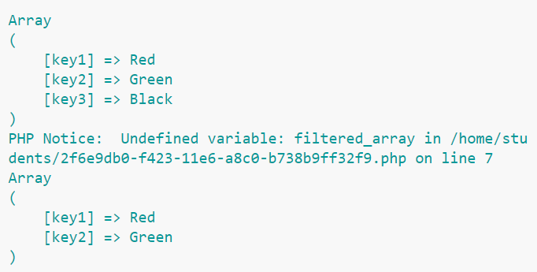
<?php
$colors = array('key1' => 'Red', 'key2' => 'Green', 'key3' => 'Black'); $given_value = 'Black';
print_r($colors);
$new_filtered_array = array_filter($colors, function ($element) use ($given_value)
{
return ($element != $given_value);});
print_r($filtered_array);
print_r($new_filtered_array);
?>

Slide 9
Write a PHP function to compares two multidimensional arrays and returns the difference.

